Slide 1

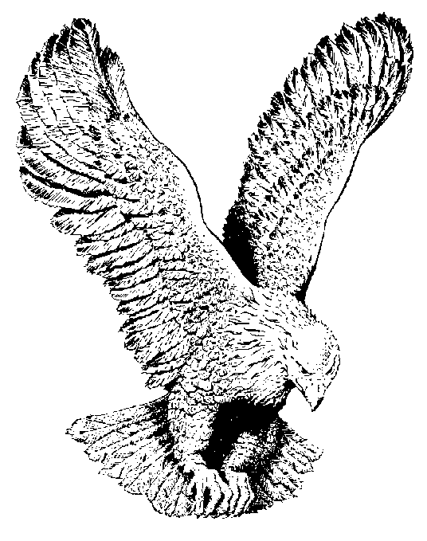
727 THREE RUSTY NAILS
With three Rusty Nails,
They nailed Jesus to the tree,
The sun turned to darkness on that day,
T’was the day that Jesus died, and the blood flowed from His side.
The blood that washed my sins away.

